Slide 1

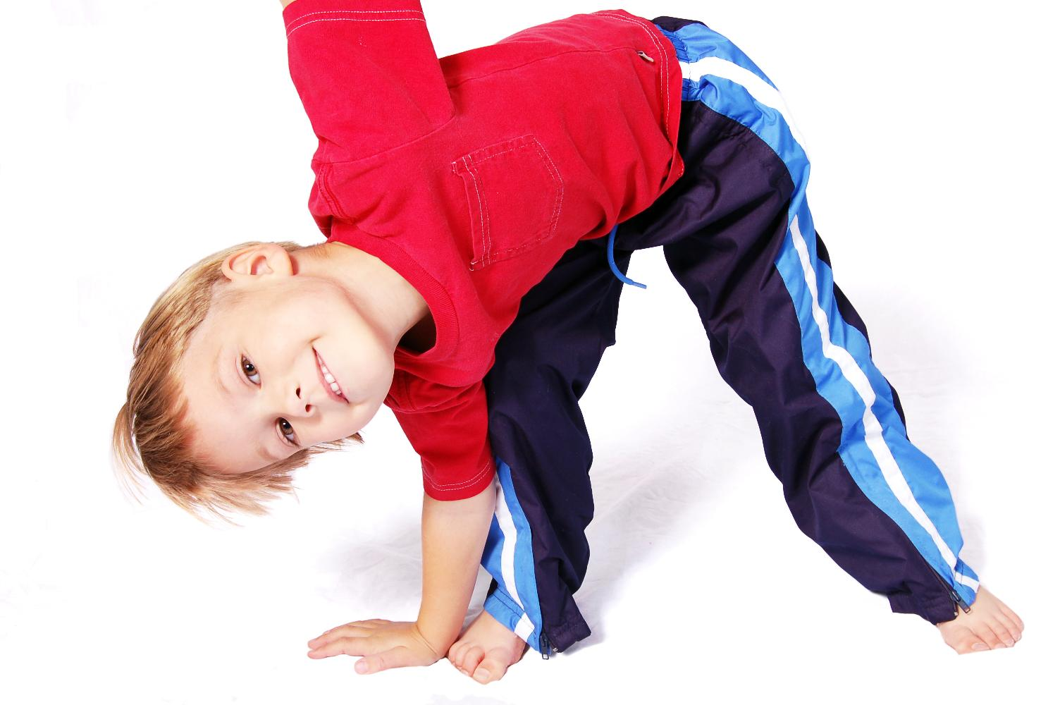
welcome

Slide 2
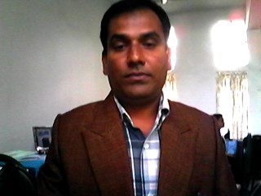


Presented by: Class: 8
Belal Ahammed Sec:-A
Asst. Teacher subject: English[1st Paper]
Shallchure High School Unit : 3, Lesson: 6
Jinaigati,Sherpur Time: 50 minutes

Slide 3
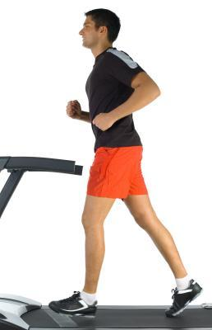


Slide 4

Physical exercise

Slide 5
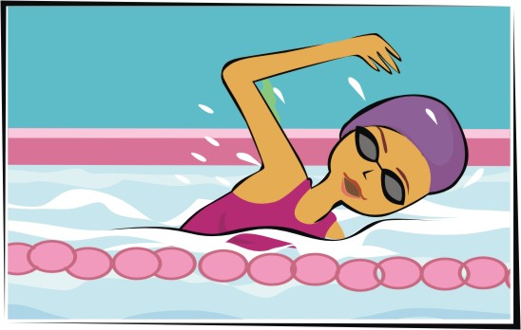

Slide 6
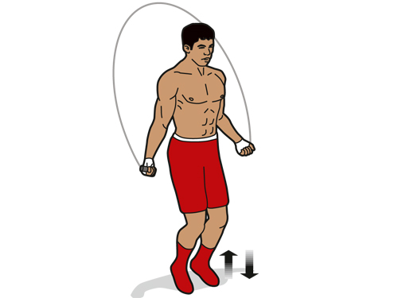

Slide 7
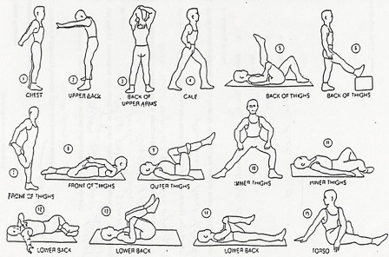

Slide 8
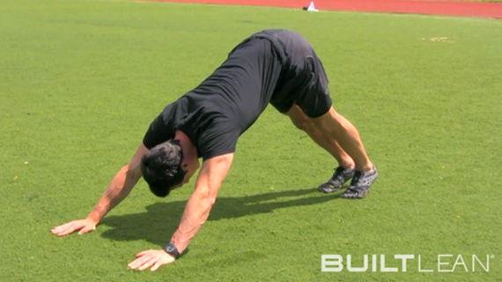

Slide 9

After studied this unit students will be able to
The benefits of physical exercise are many.
There are different kind of physical exercise.
physical exercises are need for good health.

Slide 10

Group Work
Why do you need regular physical exercise?

Slide 11

Evaluation
1.How many physical exercises are there?
2. What things are necessary for good health?
3.What does physical exercise teach you?

Slide 12


Home work
Write in your note book which can be indoors and outdoors exercise.

Slide 13


Thanks to all

